Slide 1
Registering to Vote 101
By: Jessica Silverman

Slide 2
Registration Requirements for New Jersey
A United States citizen
At least 17 years old, though you may not vote until you have reached the age of 18
A resident of the county for 30 days before the election
A person not serving a sentence of incarceration as the result of a conviction of any indictable offense under the laws of this or another state or of the United States.
Must
haves
Must
haves

Slide 3

You are ineligible to vote if…
You are serving a sentence of Incarceration as a result of a conviction of an indictable offense under the laws of this or another state or of the United States.
*The registration deadline to vote in the next election is 21 days prior to the election day*

Slide 4
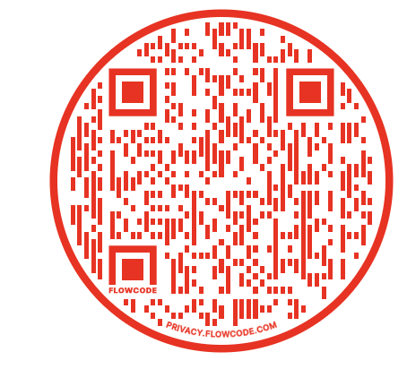
Different mediums for YOU to register…
Snapchat Social Media
https://www.snapchat.com/registertovote
Who is this for?
    This method is most popular for individuals who use Snapchat daily and/or would not prefer to complete the form on paper.
Qr-code to scan via phone camera (takes you to website)

Slide 5
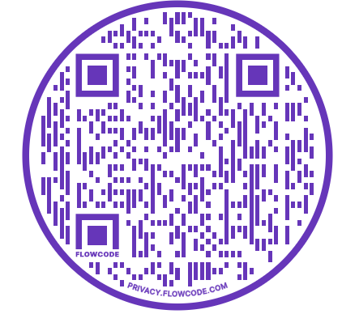
Different mediums for YOU to register…
Facebook Social Media
https://vote.gov/ (Facebook directs you to this page!)
Who is this for?
    This method is most popular for individuals who use Facebook daily and/or would not prefer to complete the form on paper.
    This method could take as few as two minutes!
Qr-code to scan via phone camera (takes you to website)

Slide 6
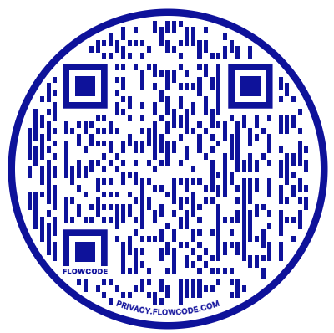
Different mediums for YOU to register…
Paper Copy to Mail-in
https://nj.gov/state/elections/assets/pdf/forms-voter-registration/68-voter-registration-english-bergen.pdf (print out)
Who is this for?
    This method is most popular for individuals who prefer to complete their voter registration form by paper.
    This method was more traditionally used in the past!
Qr-code to scan via phone camera (takes you to website)

Slide 7
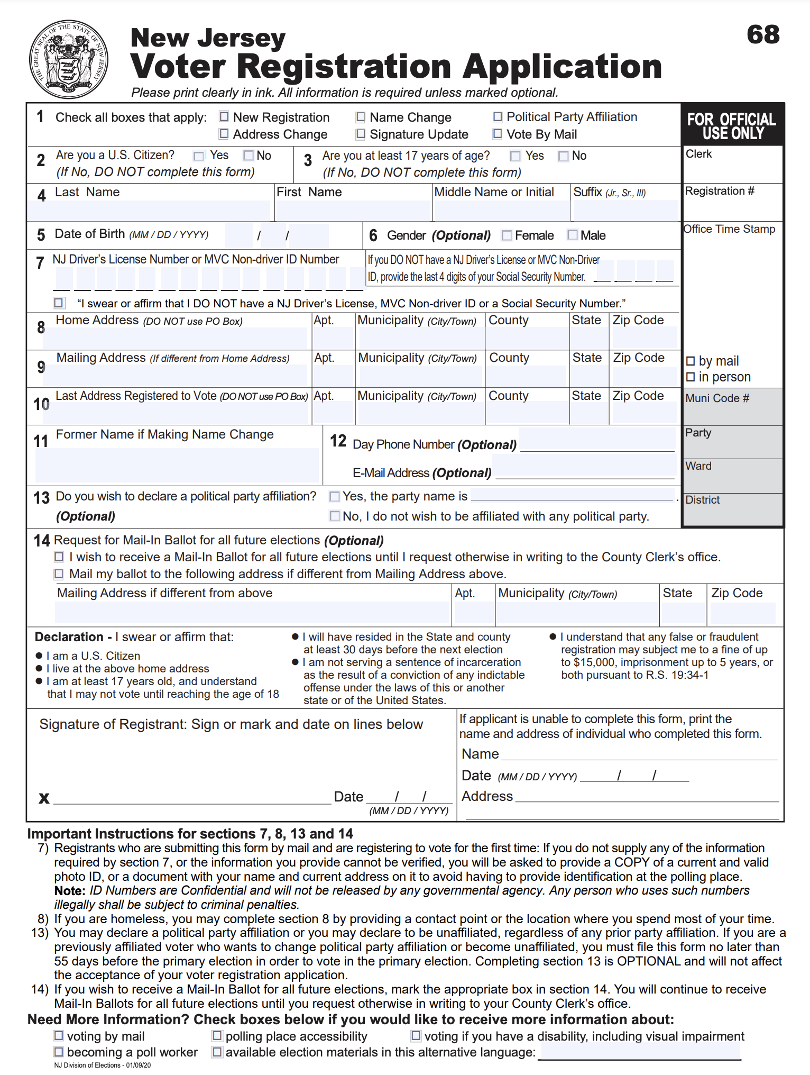
What does the PAPER version look like?
MUST READ BELOW!
MUST READ BELOW!
Forms DIFFER among New Jersey counties. This form is specific to Bergen County, NJ.
MAIL to the Bergen County Superintendent of Elections
  BERGEN COUNTY SUPERINTENDENT OF ELECTIONS 1 BERGEN COUNTY PLZ RM 380 HACKENSACK NJ 07601-9832

Slide 8

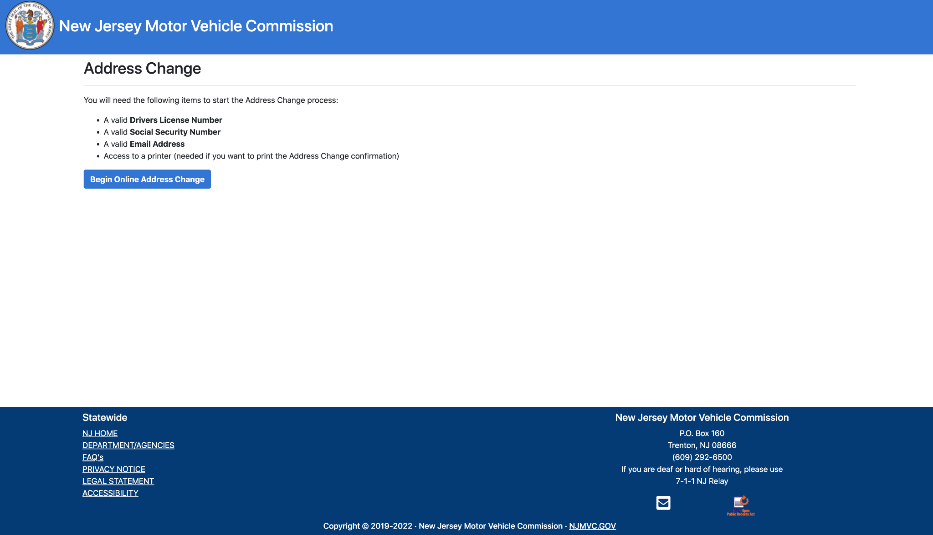
Updating YOUR registration in Bergen County~
Your voter registration (which party you are affiliated with/identification) can always be updated! There are several resources by which to do so:
https://mymvc.state.nj.us/address-change/

Slide 9
Why Should We Vote?
C
A
B
Voting 4 YOU!
Statistics
1 person → changemaker

Slide 10
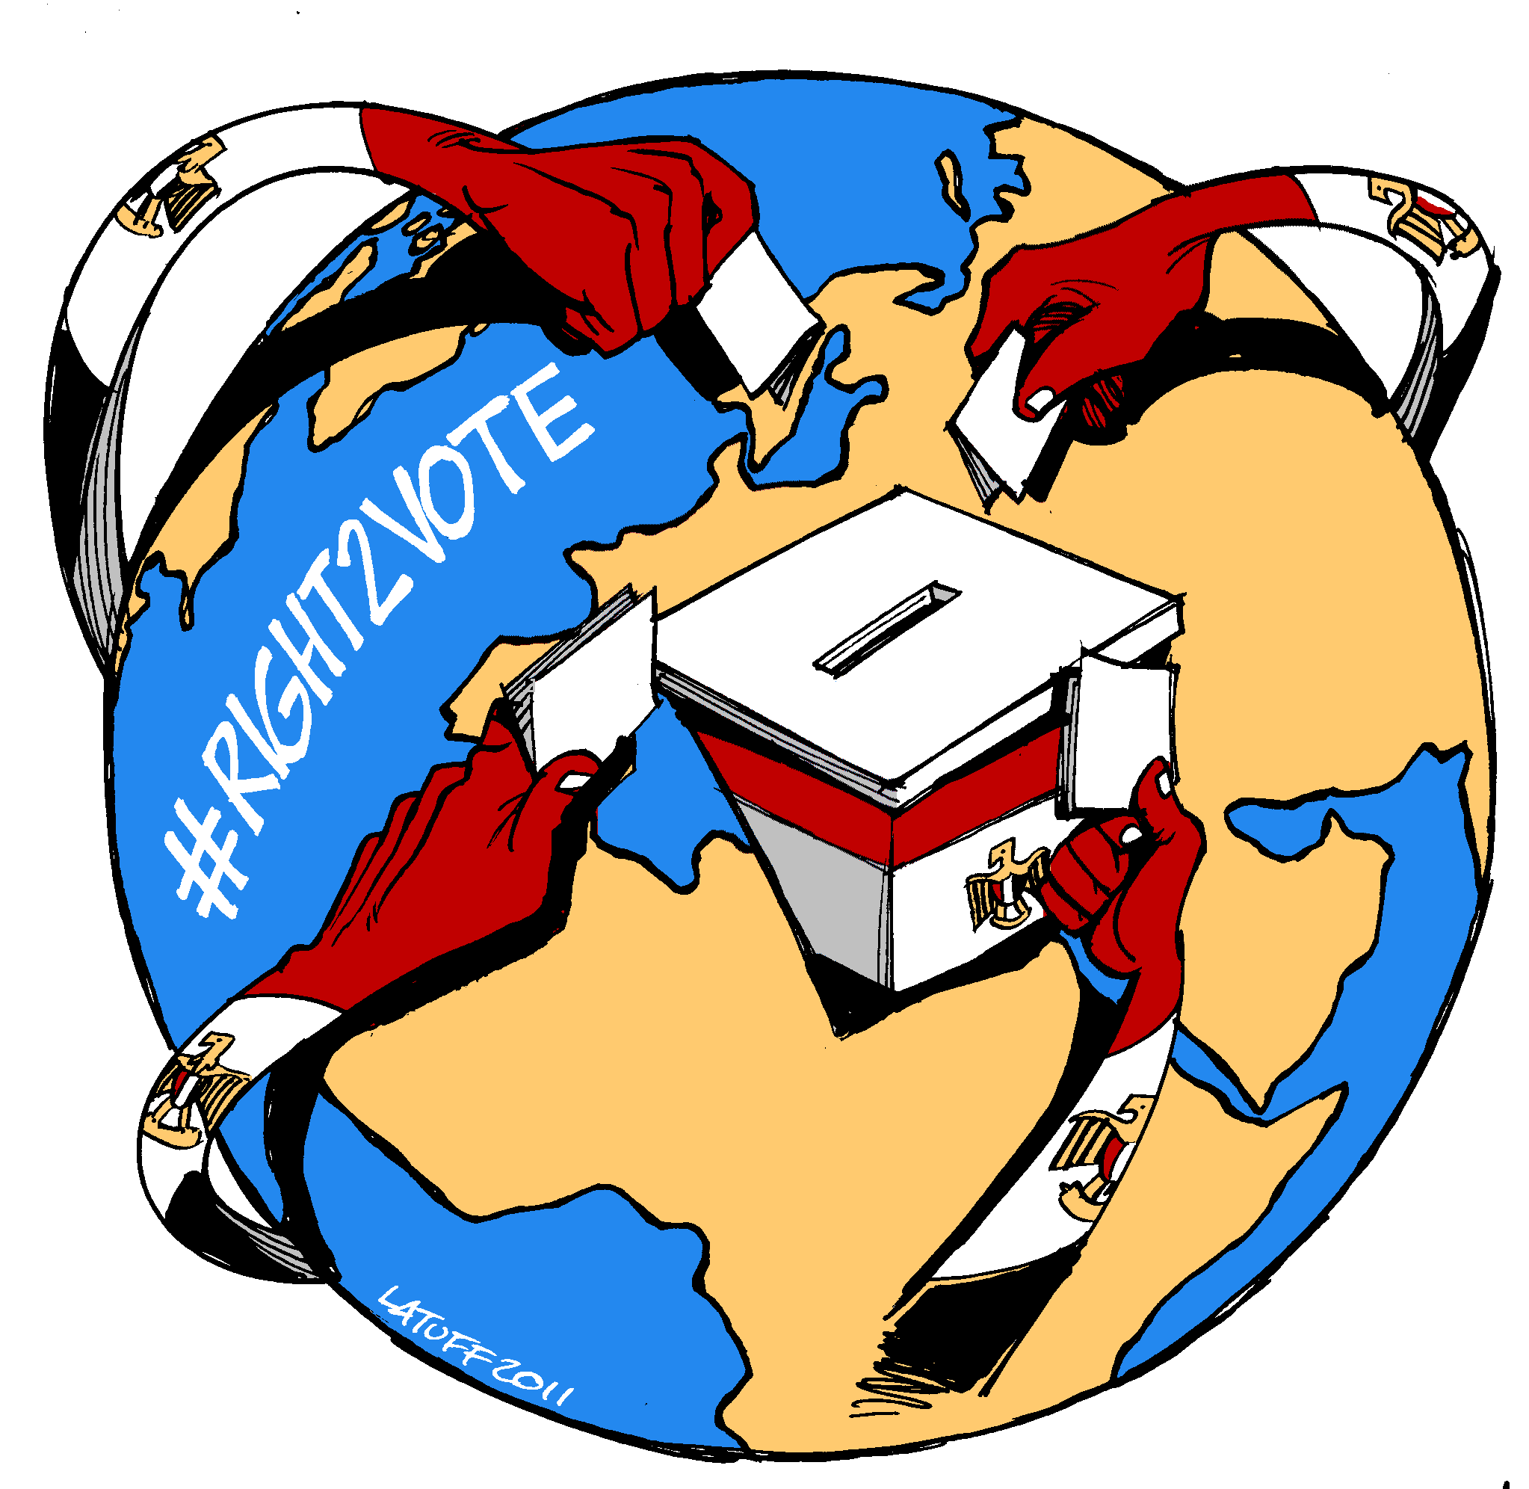
STATISTICS
Your vote could MAKE or BREAK an election!
  Check these out: 12+ tight, relevant elections
  A New Hampshire Senate race was decided by two votes out of 223,363 in 1974.
  A Massachusetts gubernatorial election was decided by two votes out of 102,066 in 1839.
  And the Alaskan congressional race was decided by a single vote out of 10,035 cast in 2008.
In most communities, the turnout for voting is less than 50 percent.
  In Bergen County, voter turnout dips as low as 9-percent (for our youth)!
Notes:
https://borgenproject.org/voting-is-important/
https://www.globalcitizen.org/en/content/why-voting-matters-motivating-facts/
https://www.npr.org/2018/11/03/663709392/why-every-vote-matters-the-elections-decided-by-a-single-vote-or-a-little-more

Slide 11
b. CHANGEMAKERS!
BALLOT
BALLOT
In your vote is possibility and change~
Vote in your best interests!
Vote for a candidate that represents your values, understands your concerns, and maintains responsibility for their actions!
By voting and voicing your concerns, you are inherently a changemaker, celebrate that!
change

Slide 12
c. Voting for YOU!
BALLOT
BALLOT
When voting, be sure to prioritize what you perceive as positive change for our country, or even county!
If you love the direction of government (at a local or larger scale) vote in your best interests!
There is no wrong or right way to vote. Voting is a personal choice that best aligns with your values and beliefs.
Your vote matters!
change

Slide 13
Sources
“7 Election Facts to Show You Why Your Vote Matters.” Global Citizen, https://www.globalcitizen.org/en/content/why-voting-matters-motivating-facts/.
Montanaro, Domenico. “Why Every Vote Matters - the Elections Decided by a Single Vote (or a Little More).” NPR, NPR, 3 Nov. 2018, https://www.npr.org/2018/11/03/663709392/why-every-vote-matters-the-elections-decided-by-a-single-vote-or-a-little-more.
Project, Borgen. “10 Facts on Why Voting Is Important.” The Borgen Project, Borgen Project Https://Borgenproject.org/Wp-Content/Uploads/The_Borgen_Project_Logo_small.Jpg, 18 June 2020, https://borgenproject.org/voting-is-important/.

